Slide 1

www.espirity.com
Java Overview
Dwight Deugo (dwight@espirity.com)
Nesa Matic (nesa@espirity.com)
Notes:
Portions of the notes for this lecture include excerpts from the Eclipse 3.0 Help facility. These excerpts are made available under CPL for ease of use by instructors, (c) Copyright (c) 2000, 2004 IBM Corporation and others. For more complete information instructors are encouraged to read the full notes from the Eclipse Help facility.

Slide 2
Additional Contributors
None as of September, 2004

Slide 3
Module Overview
Java Introduction
Java Syntax
Java Basics
Arrays
Eclipse Scrapbook

Slide 4
Module Road Map
Java Introduction
  Background
  Portability
  Compiler
  Java Virtual Machine
  Garbage collection
Java Syntax
Java Basics
Arrays
Eclipse Scrapbook

Slide 5
Java History
Originally was called the “Oak”
Was intended to be used in consumer electronics
  Platform independence was one of the requirements
  Based on C++, with influences from other OO languages (Smalltalk, Eiffel…)
Started gaining popularity in 1995
  Renamed to “Java”
  Was good fit for the Internet applications

Slide 6
Portability
Java is platform independent language
  Java code can run on any platform
  Promotes the idea of writing the code on one platform and running it on any other
Java also supports native methods
  Native methods are platform specific
  Breaks the idea of platform independence

Slide 7
Compiler
Java source code is stored in .java files
Compiler compiles code into .class files
  The compiled code is the bytecode that can run on any platform
  Bytecode is what makes Java platform independent
Bytecode is not a machine code
  The code must be interpreted in the machine code at runtime

Slide 8
Java Virtual Machine (JVM)
Platform specific
  Processes bytecode at the runtime by translating bytecode into machine code
  This means that Java is interpreted language
  JVM is different for different platforms and bytecode is the same for different platforms

Slide 9
JIT (Just-in-Time) Compiler
Translates bytecode into machine code as needed
  Improves performance as not all the bytecode is translated into machine code at once
JIT first translates bytecode into machine code
JVM than executes translated machine code
Notes:
JIT Compiler is set in the environment variable JAVA_COMPILER. For disabling JIT this variable should be set to NONE.

Slide 10
Memory Management
Automatic garbage collection is built in the language
  No explicit memory management is required
  Occurs whenever memory is required
  Can be forced programmatically
  Garbage collector frees memory from objects that are no longer in use

Slide 11
Distributed Systems
Java provides low level networking
  TCP/IP support, HTTP and sockets
Java also provides higher level networking
  Remote Method Invocation (RMI) is Java’s distributed protocol
    Used for communication between objects that reside in different Virtual Machines
    Commonly used in J2EE (Java 2 Enterprise Edition) Application Server
  CORBA could also be used with Java

Slide 12
Concurrency
Java includes support for multithreaded applications
  API for thread management is part of the language
Multithreading means that various processes/tasks can run concurrently in the application
Multithreaded applications may increase:
  Availability
  Asynchronization
  Parallelism

Slide 13
Module Road Map
Java Introduction
Java Syntax
  Identifiers
  Expressions
  Comments
Java Basics
Arrays
Eclipse Scrapbook

Slide 14
Identifiers
Used for naming classes, interfaces, methods, variables, fields, parameters
Can contain letters, digits, underscores or dollar-signs
There are some rules that apply:
  First character in the identifier cannot be a digit
    Can be a letter, underscore or dollar sign
  Literals true, false and null cannot be used
  Reserved words cannot be used
Notes:
By the convention class names begin with upper case and every subsequent word in the name is also upper case. Variables and fields begin with lower case and every subsequent word in the name is upper case.

Slide 15
Messages and Objects
Objects send messages to other objects
homePolicy.setAnnualPremium(600.00);
separator
statement ending
message receiver
message
argument
Notes:
In OO (applies for Java as well), everything is about objects and their interaction. Basics of every OO language is sending messages to objects. Object that receives a message is known as a receiver. Messages that are sent to the receiver may contain parameters. Messages are implemented as methods in the receiver’s class and parameters passed in a message are defined as arguments in those methods.
Operator “.” (dot) is used for sending messages to objects as it separates message from the object that receives the message.
Semicolon indicates end of Java statement.

Slide 16
Expressions
Statements are the basic Java expressions
  Semicolon (;) indicates end of a statement
variable declaration
HomePolicy homePolicy;
double premium;
premium = 100.00;
homePolicy = new HomePolicy();
homePolicy.setAnnualPremium(premium);
variable assignment
object creation
message sending
Notes:
In the above code we see few examples of Java expressions that include variable declaration, variable assignment,
object creation, and sending message to an object. In the statement where object is created, we first create the object (new HomePolicy()) and than assign the result to the homePolicy variable.

Slide 17
Empty Expression
Semicolon on its own in the line
  Can be used to indicate do nothing scenario in the code
  We would expect the code to print 0,1,2 but it prints only 0 because of the empty statement
; //this is an empty statement
for(int i=1; i<3; i++) ;
System.out.println(i);

Slide 18
Comments
There are 3 different types of comments in Java:
  Single line comment
    Starts with // and ends at the end of the line
  Multiple line comment
    Starts with /* and ends with */
  Javadoc comment
    Starts with /** and ends with */
    Used by Javadoc program for generating Java documentation

Slide 19
Comments Example
/** Javadoc example comment.
* Used for generation of the documentation.
*/
/* Multiple line comment.
*
*/
// Single line comment.
Notes:
Javadoc program that is part of JDK, can use the structure of Java and Javadoc comments to automatically generate a set of HTML files describing the source code.

Slide 20
Literals
Represent hardcoded values that do not change
Typical example are string literals
  When used compiler creates an instance of String class
String one = "One";
String two = "Two";
String one = new String("One");
String two = new String("Two");
Notes:
String literals are commonly used in Java.

Slide 21
Module Road Map
Java Introduction
Java Syntax
Java Basics
  Java types
  Primitives
  Objects
  Variables
  Operators
  Identity and equality
Arrays
Eclipse Scrapbook

Slide 22
Java and Types
There are two different types in Java:
  Primitive data type
  Reference type
It is said that Java is strongly typed language
  Fields, variables, method parameters and returns must have a type
variable name
double premium;
HomePolicy homePolicy;
variable type
Notes:
With strongly typed language if a method asks for a parameter of one type and it is passed an object which is an instance of another type, the compiler will not be able to compile the code and will point out that error.
With non strongly typed language errors can be caught only at the runtime.

Slide 23
Primitives
Primitives represent simple data in Java
Primitives are not objects in Java
  Messages cannot be sent to primitives
  Messages can be sent to other Java objects that represents primitives
    These are known as wrapper objects in Java ( such as Double, Integer, and Boolean)

Slide 24
Primitives Operators
Keyword | Description | Keyword | Description | Keyword | Description
+ | add | < | lesser | & | and
- | subtract | > | greater | | | or
* | multiple | = | assignment | ^ | xor
/ | divide | >= | greater equal | ! | not
% | reminder | <= | less equal | && | lazy and
(…) | the code within is executed first | == | equals | || | lazy or
++op | increment first | != | not equal | << | left bit shift
--op | decrement first | x+=2 | x=x+2 | >> | right bit shift
op++ | increment after | x-=2 | x=x-2 | >>> | right bit shift with zeros
op-- | decrement after | x*=2 | x=x*2
Notes:
x << k
Shifts bits in x for k places to the left, filling bits on the right with zeros
x >> k
Shifts bits in x for k places to the right, filling bits on the left with the highest bit (sign bit)
x >>> k
Shifts bits in x for k places to the right, filling bits on the left with zeros

Slide 25
Primitive Types
Keyword | Size | Min value | Max value
boolean | true/false
byte | 8-bit | -128 | 127
short | 16-bit | -32768 | 32767
char | 16-bit Unicode
int | 32-bit | -2147483648 | 2147483647
float | 32-bit
double | 64-bit
long | 64-bit | - 9223372036854775808 | 9223372036854775807

Slide 26
boolean Type
Commonly used in control statements
Consists of two boolean literals:
  true
  false
Keyword | Description
! | complement
& | and
| | or
^ | exclusive or
&& | lazy and
|| | lazy or
!true //false
true & true //true
true | false //true
false ^ true //true
true ^ false //true
false ^ false //false
true ^ true //false
false && true //false, second operand does not evaluate
true || false //true, second operand does not evaluate
Notes:
With lazy and if left operand evaluates to false than false is the result without evaluating right operand.
With lazy or if left operand evaluates to true than true is the result without evaluating right operand.

Slide 27
char Type
Represents characters in Java
Uses 16-bit unicode for support of internationalization
Character literals appear in single quotes, and include:
  Typed characters, e.g. 'z'
  Unicode, e.g. '\u0040', equal to '@'
  Escape sequence, e.g. '\n'
Notes:
In Java, ASCII characters can be written directly, for example ‘a’, ‘b’, etc. Non-ASCII characters can be written in their octal or hexadecimal codes. In hexadecimal code \u is followed by decimal digits (four digits) and in octal code \ is followed by octal digits (three digits).

Slide 28
Escape Sequence Characters
Commonly used with print statements
Escape sequence | Unicode | Description
\n | \u000A | New line
\t | \u0009 | Tab
\b | \u0008 | Backspace
\r | \u000D | Return
\f | \u000C | Form feed
\\ | \u005C | Backslash
\’ | \u0027 | Single quote
\” | \u0022 | Double quote

Slide 29
Numeric Types
There are generally two different types:
  Integer: byte, short, int, and long
  Floating-point: float, and double
Literals can be used for all but byte and short types
  An int is converted to byte if it fits to 8-bits
  An int is converted to short if it fits to 16-bits
12 //decimal integer 12
12L //long decimal 12
0x1E //hexadecimal integer 30
23.f //float
30.7 //double
Notes:
When an operation is performed on 2 different numeric types Java converts lesser type to a greater type and than perform operation.

Slide 30
Manipulating Numeric Types
A lesser type is promoted to greater type and than operation is performed
A greater type cannot be promoted to lesser type
  Assigning double value to int type variable would result in compile error
12 + 24.56 //int + double = double
int i = 12;
double d = 23.4;
i = d;
Type mismatch
Notes:
In the above example an error would indicate type mismatch as double type cannot be converted to int type.
If int type were assigned to double type, integer 12 would be converted to double 12.00 and assigned to variable d.

Slide 31
Type Casting
Values of greater precision cannot be assigned to variables declared as of lower precision types
Type casting makes primitives to change their type
  Used to assign values of greater precision to variables declared as lower precision
    e.g. it’s possible to type cast double to int type
int i = 34.5; //compiler error - type mismatch
int i = (int)34.5; //explicit type casting

Slide 32
Bitwise Operators
~x
  Bitwise complement of x
x & y
  Bitwise and for x and y
x | y
  Bitwise or for x and y
x ^ y
  Bitwise exclusive or for x and y
Notes:
When the bitwise operators are applied both operands are always evaluated.

Slide 33
Conditional Expression
x ? y : z
  x must be type boolean, y and z can be of any type
  Evaluates to y if x is true, otherwise evaluates to z
(1 == 1) ? 7 : 4 //evaluates to 7
(1 == 2) ? 7 : 4 //evaluates to 4

Slide 34
Reference Types…
Reference types in Java are class or interface
  They are also known as object types
If a variable is declared as a type of class
  An instance of that class can be assigned to it
  An instance of any subclass of that class can be assigned to it
If a variable is declared as a type of interface
  An instance of any class that implements the interface can be assigned to it
Notes:
Later in the course you will see reference types more in depth when covering Inheritance and Interfaces.

Slide 35
…Reference Type
Reference type names are uniquely identified by:
  Name of the package where type is defined (class or interface)
  Type name
This is full qualifier for the type and it is full qualifier for class or interface
java.lang.Object
com.espirity.demo.models.Policy
Notes:
Classes and interfaces are uniquely identified by their package names and their names. When referencing class or interface full qualifier must be specified, otherwise the type won’t be found. The exception are classes from java.lang package. When using these classes there is no need to use package name. Also it is possible to use import statements to point to certain packages and types, and than simply refer to types from those packages.

Slide 36
Object Operators
Keyword | Description
instanceof | object type
!= | not identical
== | identical
= | assignment
Notes:
Operator = is same for primitives and objects. Operators == and != are different as they mean equality for primitives and identity for objects.

Slide 37
Creating Objects in Java
Objects are, in Java, created by using constructors
Constructors are methods that have same name as the class
  They may accept arguments mainly used for fields initialization
  If constructor is not defined, the default constructor is used
HomePolicy firstPolicy = new HomePolicy();
HomePolicy secondPolicy = new HomePolicy(1200);
Notes:
Constructors are used for creating objects. If constructor is not defined in the class, than the default constructor from the Object class is used. The default constructor is one with no arguments. Once constructor is defined in a class the default constructor cannot be used any more unless also defined in the class. Let’s say that you create class HomePolicy. Without defining any constructor in the class you can use HomePolicy() constructor (new HomePolicy()) for creating an instance of the class. Let’s say that than you added constructor HomePolicy(double) to the HomePolicy class. If you try using the default constructor, compile error will occur. You have to use the constructor you’ve defined unless you add the default constructor to the class.

Slide 38
Reference Types and Variables
Policy policy;
policy = new Policy();
policy = new LifePolicy();
policy = new HomePolicy();
policy = new AutoPolicy();
Policy
LifePolicy
HomePolicy
AutoPolicy
Building
Vehicle
Policyable policyable;
policyable = new House();
policyable = new Auto();
<<interface>>
Policyable
House
Auto
Notes:
If a variable is declared as a type of class, an instance of that class can be assigned to it, or an instance of any subclass of that class can be assigned to it.
If a variable is declared as a type of interface, an instance of any class that implements the interface can be assigned to it.
Variable policy is declared as Policy type, so any instance of classes Policy, LifePolicy, HomePolicy, and AutoPolicy can be assigned to it.
Variable policyable is declared of type Policyable, so any instance of class House, and class Auto can be assigned to it.

Slide 39
Type Casting on Objects
Allows for messages to be sent to subtype
  Variables declared as type of superclass
The declared type of the variable stays the same
  In the example variable policy stays of type Policy after casting
Policy policy;
policy = new AutoPolicy();
((AutoPolicy)policy).getAuto();

Slide 40
Assignment
Assigning an object to a variable binds the variable to the object
HomePolicy firstPolicy =
new HomePolicy(1200);
aHomePolicy
1200
aHomePolicy
HomePolicy firstPolicy =
new HomePolicy(1200);
HomePolicy secondPolicy =
new HomePolicy(1200);
firstPolicy = secondPolicy;
1200
aHomePolicy
1200
aHomePolicy
1200
Notes:
In the first example above new home policy is assigned to the variable firstPolicy. This means that the variable is bound to the newly created object, and it references that object.
In the second example above, firstPolicy and secondPolicy variables are first bound to 2 different home policy objects, so they reference different objects. Than firstPolicy is assigned secondPolicy, which means that it is bound to object that secondPolicy variable references. After this line, both variables are bound to the same object and reference the same object.

Slide 41
Identical Objects…
Operand == is used for checking if two objects are identical
  Objects are identical if they occupy same memory space
int x = 3;
int y = 3;
x == y; //true
3
aHomePolicy
HomePolicy firstPolicy =
new HomePolicy(1200);
HomePolicy secondPolicy =
new HomePolicy(1200);
firstPolicy == secondPolicy; //false
1200
aHomePolicy
1200
Notes:
When == operand is used for primitives, their values are compared. In the above example both variables (x, and y) have same primitive value (3) and result of comparing identities of variables is true.
When == operand is used on variables that contain objects, objects references are checked. If variables reference same object, result of comparing them is true, otherwise is false.
In the second example both variables (firstPolicy, and secondPolicy) contain an instance of HomePolicy, but those are different instances, and variables reference different objects. Result of comparing them is false.

Slide 42
…Identical Objects
Variables that reference objects are compared by value
  Objects are identical if their memory addresses are the same
Variables are identical if they refer to exactly same instance of the class
HomePolicy firstPolicy = new HomePolicy(1200);
HomePolicy secondPolicy = firstPolicy;
firstPolicy == secondPolicy; //true
aHomePolicy
1200
Notes:
In the above example both variables (firstPolicy, and secondPolicy) point to the same object, and == operand between them returns true.

Slide 43
Equal Objects
Determined by implementation of the equals() method
  Default implementation is in the Object class and uses == (identity)
  Usually overridden in subclasses to provide criteria for equality
HomePolicy firstPolicy =
new HomePolicy(1200,1);
HomePolicy secondPolicy =
new HomePolicy(1200,1);
firstPolicy.equals(secondPolicy); //false
Notes:
Two objects should be equal if some of their fields are equal. For example, 2 home policies should be equal if their clients, houses and premiums are equal.
In the above example the default implementation of the equals() method (in the Object class) is used and returns false when home policies are compared for equality. If HomePolicy class overrides equals() method and uses equality of object fields as criteria, the above example would return true when policies are compared for equality.

Slide 44
null
Used to un-assign object from a variable
  Object is automatically garbage collected if it does not have references
When a variable of object type is declared it is assigned null as a value
String one = "One";
one = null;
one = "1";
HomePolicy policy;
policy = new HomePolicy(1200);
…
if (policy != null)
System.out.println(policy.toString());
Notes:
The common check in Java programming is if a variable refers to null. It is used before message are sent to the variable, to prevent null pointer exception from occurring.
In the above example a home policy is not equal to null is performed before a message toString() is sent to it.

Slide 45
Module Road Map
Java Introduction
Java Syntax
Java Basics
Arrays
  What are arrays?
  Creating arrays
  Using arrays
Eclipse Scrapbook

Slide 46
What is an Array?
Arrays are basic collections in Java
  They contain elements of the same type
  Elements can either be Java objects or primitives
Arrays are fixed-size sequential collection
  Size is predefined, and arrays cannot grow
Arrays are objects
  Declaration, creation, and initialization is different for arrays than for other objects

Slide 47
Array Basics
The first element in array is at the zero index
Arrays are automatically bounds-checked
  When accessing elements that are out of bounds, an exception will be thrown
  For example, accessing element at index 6 in the above example will throw the exception
0
1
2
3
4
5
Notes:
In the above graphics we see an array of 6 elements, and the numbers represent indices of the array elements.

Slide 48
Creating Arrays…
Arrays store objects of specific type
  One array cannot store objects of different types, String and int for example
To define a variable that holds an array, you suffix the type with square brackets []
  This indicates that variable references an array
int[] arrayOfIntegers;
String[] arrayOfStrings;
Notes:
Example above shows one way of declaring arrays. That is with suffixing the variable type with the square brackets []. It is also possible to do that with variable name, or with both, type and the name.
The first array in the above example will only store primitives of type int, while the second array will only store String objects.

Slide 49
…Creating Arrays…
Alternative ways to define an array include:
  Suffixing variable name with brackets
  Suffixing both variable name and the type with brackets
int arrayOfIntegers[];
String arrayOfStrings[];
int[]arrayOfIntegers[];
String[] arrayOfStrings[];
Notes:
There is no difference in any of the ways of declaring arrays. There is no advantages in using one over another.

Slide 50
…Creating Arrays
There are two ways to create an array:
  Explicitly using the keyword new
  Using array initializer
When creating an array explicitly its size must be specified
  This indicates desired number of elements in the array
  Elements in the array are initialized to default values
int arrayOfIntegers[];
arrayOfIntegers = new int[5];
Notes:
In the example above new array of type int is created and it is indicated that its maximum size is 5. This means that 5 elements can be stored in the array. Arrays are of a fixed-size and are collections that cannot grow.
When an array is created its elements are initialized to default values. In other words, if array is of type int, all of its elements will be initialized to 0. If array is holding Java object types, its elements will be initialized to null values.

Slide 51
Array Initializer
Used for creating and initializing arrays
  Array elements are initialized within the curly brackets
Can only be used when declaring variable
  Using array initializer in a separate step will result in a compilation error
int[] arrayOfIntegers = {1,2,3,4,5};
int[] arrayOfIntegers;
arrayOfIntegers = {1,2,3,4,5};
Notes:
Number of elements in the initializer define size of the array. In the first example above, the size of array is 5, i.e array can hold only 5 elements.
In the second example above, compilation error will occur as using initializer after declaration is not allowed.

Slide 52
Initializing Arrays
If not using initializer, an array can be initialized by storing elements at proper index
int[] arrayOfIntegers;
arrayOfIntegers = new int[5];
arrayOfIntegers[0] = 1;
arrayOfIntegers[1] = 2;
arrayOfIntegers[2] = 3;
arrayOfIntegers[3] = 4;
arrayOfIntegers[4] = 5;
Notes:
An array can be initialized after creation by storing element at an index. Keep in mind here that arrays are zero-indexed, which means that the first element is at the index 0.

Slide 53
Manipulating Arrays
An element of the array is accessed by accessing index at which element is stored
An array size can be obtained by asking for its length
  Used commonly in control statements (loops)
Console
int[] arrayOfIntegers = {1,2,3,4,5};
System.out.println(arrayOfIntegers[2]);
3
Console
int[] arrayOfIntegers = {1,2,3,4,5};
System.out.println(arrayOfIntegers.length);
5
Notes:
Array length is commonly used with the control statements, when looping through the array, where array length is first obtained and than looping is done for that length.

Slide 54
Multi-Dimensional Arrays
An array can contain elements of other arrays
  Such an array is known as multi-dimensional array
  There is no limit is number of dimensions
    Arrays can be 2-dimensional, 3-dimensional, and n-dimensional
int[][] arrayOfIntegers = new int[2][5];
Notes:
A two-dimensional array is declared in the example above. This array has two elements and each element is an array on its own, and has 5 elements of type int in it.
When seeing an array declared like that you can think of a matrix with 2 rows and 5 columns with integers as elements in the matrix. In reality there are 2 array elements, with an array of 5 integer elements in each of them.

Slide 55
Manipulating Multi-Dimensional Arrays
Multi-dimensional arrays are created like any other arrays
  Using the keyword new
  Using array initializers
Elements in multi-dimensional array are also accessed using their indices
int[][] arrayOfIntegers = {{1,2,3,4,5},{6,7,8,9,10}};
int[][] arrayOfIntegers = {{1,2,3,4,5},{6,7,8,9,10}};
System.out.println(arrayOfIntegers[1][2]);
8

Slide 56
Module Road Map
Java Introduction
Java Syntax
Java Basics
Arrays
Eclipse Scrapbook
  Creating and using Scrapbook
  Evaluating expressions
  Displaying and inspecting values
  Eclipse content assist

Slide 57
Scrapbook…
Allows for writing and executing of Java code
  Very useful for quick test of Java code that you write
The Java code in the Scrapbook can be:
  Displayed as a string when evaluated
  Inspected when evaluated
    Opens an Inspector view where you can see returning object from evaluation and all containing fields
  Executed

Slide 58
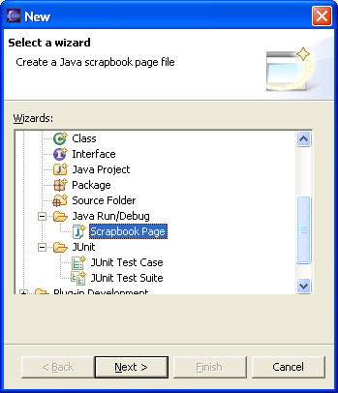
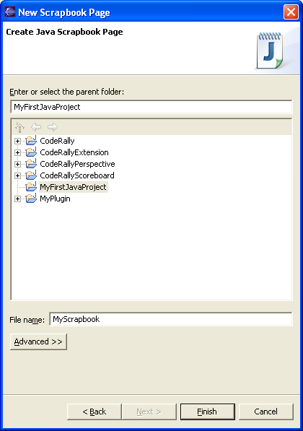
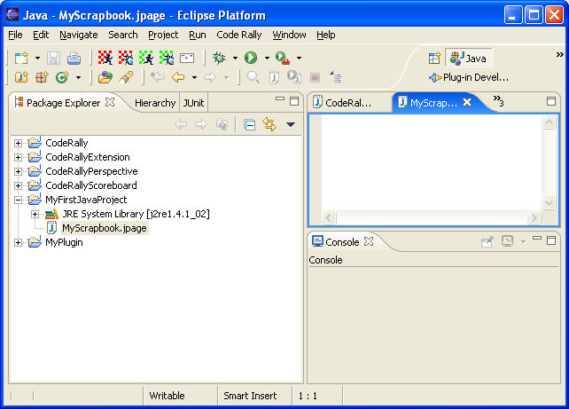
…Scrapbook…
It is created by selecting a project and choosing New → Other… → Java → Java Run/Debug from the Package Explorer’s context menu and then entering the name of the page
Your scrapbook page will become a resource in your project

Slide 59
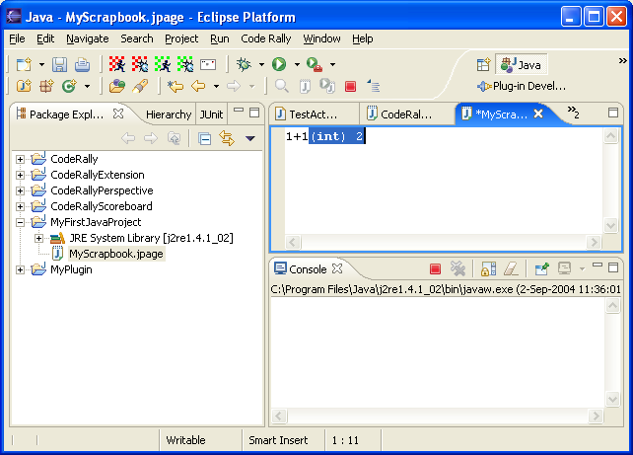
… Scrapbook…
To open the scrapbook page just click on the resource
It opens up like a Java source file editor
Type Java code and select the context menu to Display or Inspect

Slide 60
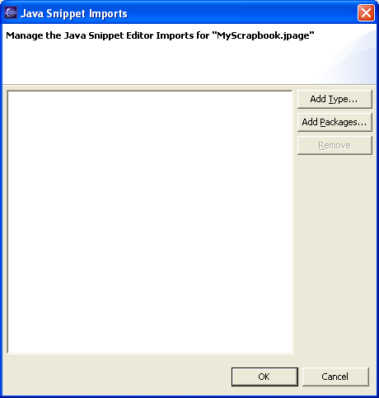
…Scrapbook
Class names must be fully qualified in what you type
Set imports to make life easier
Think of your scrapbook as a page that Eclipse will take the source you type, wrap it in a class with your source in the main menu, then compile and execute

Slide 61
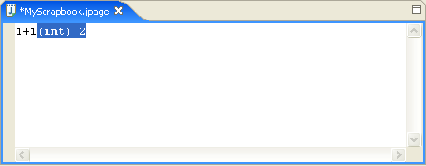
Evaluating and Displaying Results
Expressions can be evaluated in the Scrapbook
  Highlight the expressions and choose Display from the context menu
  Result shows up in the Scrapbook

Slide 62
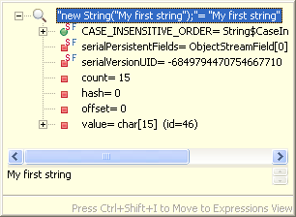
Inspector
Code could also be inspected in the Scrapbook by highlighting it and selecting Inspect from the context menu
Notes:
Using the inspector objects can be inspected. The above example shows result of inspecting new String(“My first String expression”). Objects that are contained within other objects can also be seen in the inspector.

Slide 63
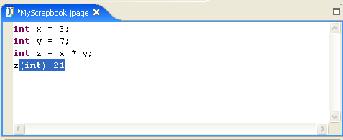
Scrapbook and Multiple Expressions
Multiple expressions can also be evaluated in the Scrapbook
The result of evaluating is always last expression evaluated
Notes:
When using Scrapbook return result is always last expression evaluated. In the example above if we didn’t have z at the end, it wouldn’t know what last expression evaluates to as it is assignment to a variable.

Slide 64
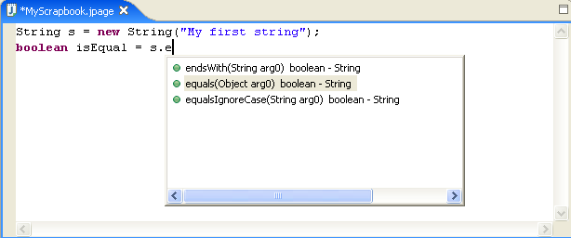
Content Assist
Helps with writing code in Eclipse
Invoked after message operator (dot)
  Displays all messages that can be sent to the receiver
Notes:
Content assist looks into receiver’s class and displays all methods defined in that class.

Slide 65
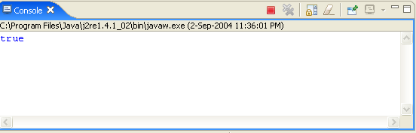
Console
Represents standard Java output in Eclipse
String s = new String("My First String");
boolean isEqual = s.equals("My First String");
System.out.println(isEqual);

Slide 66
Review
In this module we discussed:
  Java Background
  Java Overview
  Java Syntax
  Basics of the Java language
  Primitives, Variables, Types
  Arrays
  How to create and use Eclipse Scrapbook

Slide 67

Labs!
Lab: Java Overview

